Slide 1
VIZ1, Session 5
Exploratory Visualizations

Slide 2
Designing visualizations
We design visualizations in 4 main steps
Always iterate over a design using outside feedback
The steps are
  Explore dataset
  Generate ideas
  Select visualization type
  Implement

Slide 3
(1) Exploring a dataset
What type of dataset is it?
What are the types of data in the set?
Which attributes are available for display?
What are their types?

Slide 4
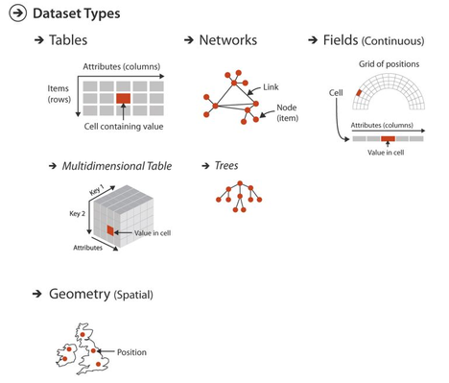
Dataset Types
Tables
  Items (rows) containing keys + values
Networks (graphs) and trees
  Items (nodes) and links (edges)
Fields
  Cells (items) arranged in a grid
Spatial (geodata)
  Items arranged in physical locations

Slide 5
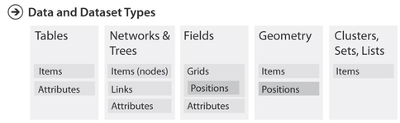
Data Types
Items
  Items consist of attributes
  In tables, one or more attributes are keys and the rest are values
Links are connections between items
  Typically used in networks
Positions are 2D or 3D locations
Attributes contain singular data

Slide 6
Attribute Types
 | Discrete | Continuous
Ordered
Unordered

Slide 7
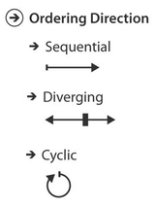
Ordering direction
Sequential
  Starting from a minimum (e.g. 0) and up
Diverging
  Going either way from a neutral midpoint
Cyclic
  When the maximum is semantically similar to the minimum

Slide 8
Design workshop (1): Data Exploration
Form groups
Find the data sets given in itslearning
Explore the data, find
  The dataset type
  The data types
  (If applicable) The attribute types (Including keys and values)
  (If applicable) Ordering directions
Compare with another group

Slide 9
Exploratory vs Expository Visualization
Exploratory
Expository
Open-ended
Facilitates the user in drawing conclusions about the data
Leads to further questions
Actions: Discover, lookup, browse, explore, compare
Closed-ended
Communicates a message about the data
Presents evidence for a given conclusion
Actions: Present, summarize, compare

Slide 10
Question
Consider the "hipster summer reading" data set
Which of these questions would you classify as exploratory/expository?
  ”Which books are the most obscure and still highly rated on Goodreads?”
  ”Why are the highly rated books often not the ones most frequently borrowed?”
  ”How does the number of borrows relate to a book’s Goodreads score?”

Slide 11
Asking Questions about the data
Jumping straight from data to visualization misses
  The point of the visualization
  Many ideas that could have been explored
Try finding the questions that could be answered using a visualization
Good keywords to lead to questions:
  Comparison
  Distribution
  Composition
  Trend
  Relationship
  Ranking
  Change
  Outliers
  Clusters

Slide 12
Design workshop (2): Generate Questions
Each groups picks 1 of the 3 datasets
Generate as many exploratory questions as you can
  It should be possible to generate 15 questions
Groups that chose the same data set compares and discusses

Slide 13
From Questions to Tasks
Questions are dependent on
  Domain
  Forms of expression
  Concrete data
Tasks are generic forms that we can work with
Example:
  Which music format generates the most revenue?
  What books are borrowed the most?
  Which country has the largest CO2-footprint?
Are examples of the task
  Compare features

Slide 14
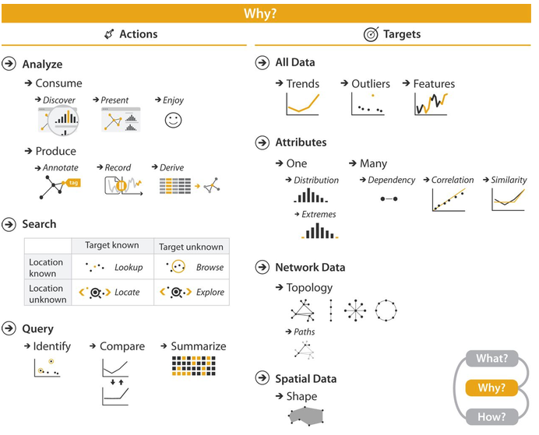
Actions and Targets

Slide 15
Example Visualizations for Search Tasks
Task | Description | Hipster Books example | Possible visualization(s)
Lookup | Find the value of a specific item that is already known. | What is the average rating of The Goldfinch? | Table, tooltip, annotated bar chart
Locate | Find one or more items satisfying known criteria. | Find books with a rating above 4.5. | Scatter plot, sortable table, filtered bar chart
Browse | Examine a subset of the data without knowing the exact target. | Browse all Fantasy books to see if anything stands out. | Interactive table, treemap, sortable bar chart
Explore | Search the dataset openly to discover interesting patterns or hypotheses. | Is there an interesting relationship between book length, ratings, and borrow count? | Scatter plot, dashboard

Slide 16
Example Visualizations for Query Tasks
Task | Description | Hipster Books example | Possible visualization(s)
Identify | Determine properties or membership of an item. | Which books belong to the Science Fiction genre? | Colored bar chart, treemap, highlighted table
Compare | Compare values between two or more items. | Which genre has the highest average rating? | Bar chart, scatter plot
Summarize | Describe the overall characteristics of a dataset or subset. | How are book ratings distributed? | Histogram, heatmap

Slide 17
Design Workshop (3): From Data to Visualization
Work in the same groups
Generate visualization using the procedure sketched in the uploaded document: From Data to Visualization.

